Slide 1

Peergrader April 12, 2024
Christian Knab (SCRUM Master), Aastha Verma, Eric Chuang, Eliah Reeves (Product Owner)

Slide 2

01
Why Peergrader?

Slide 3
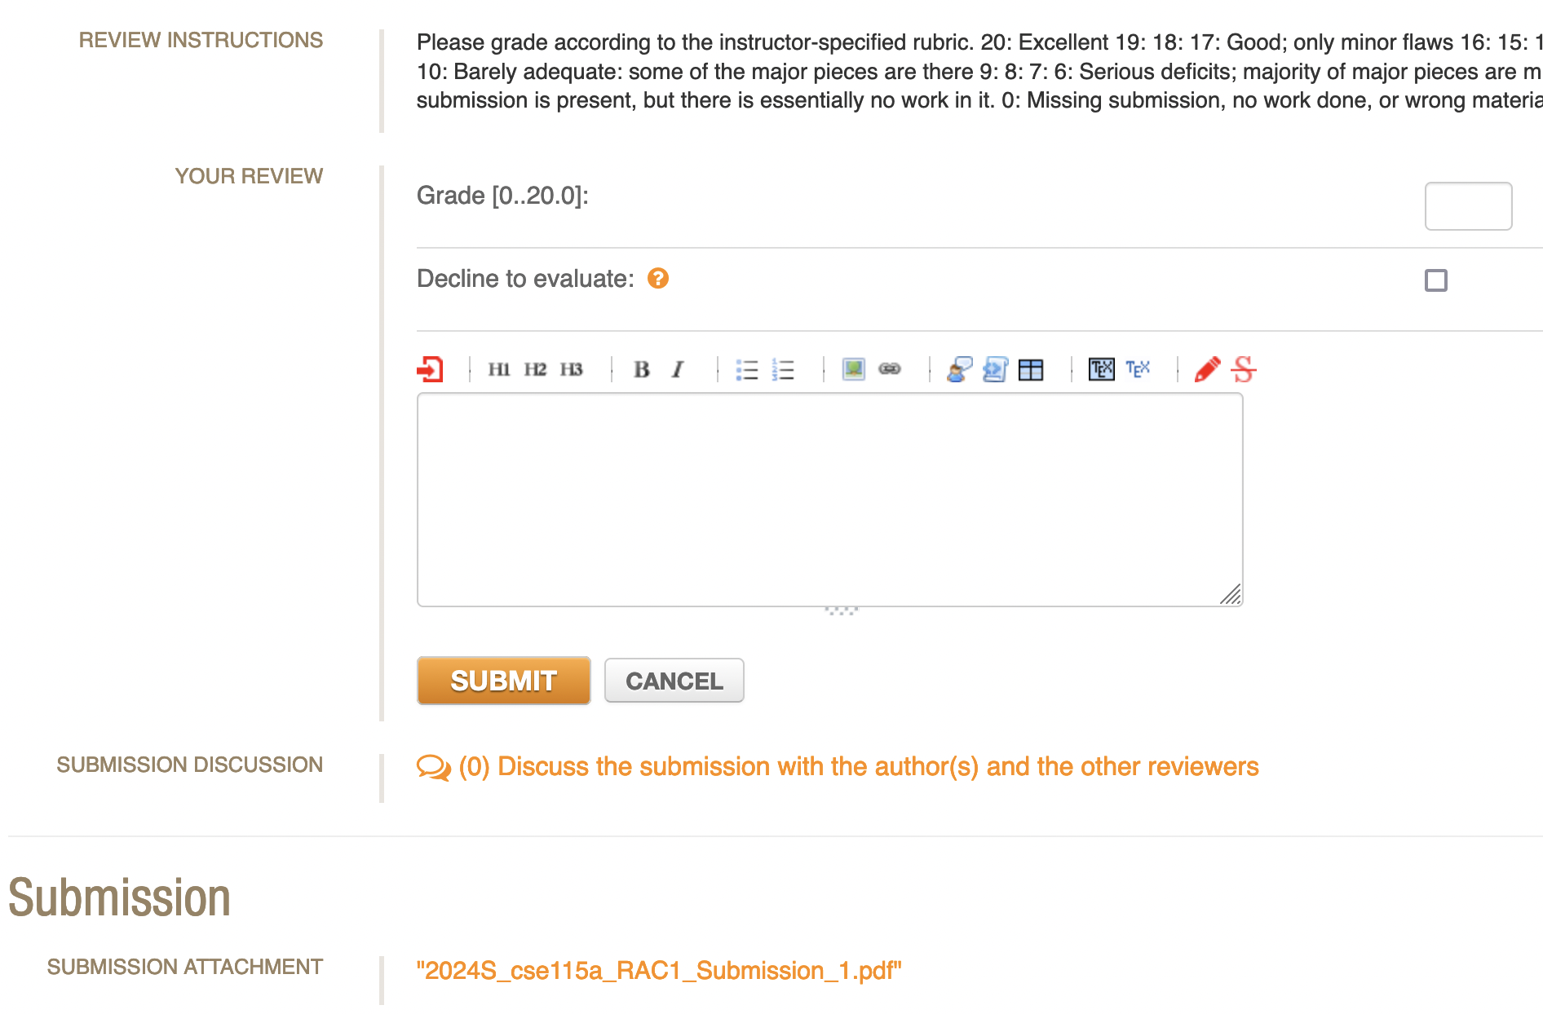
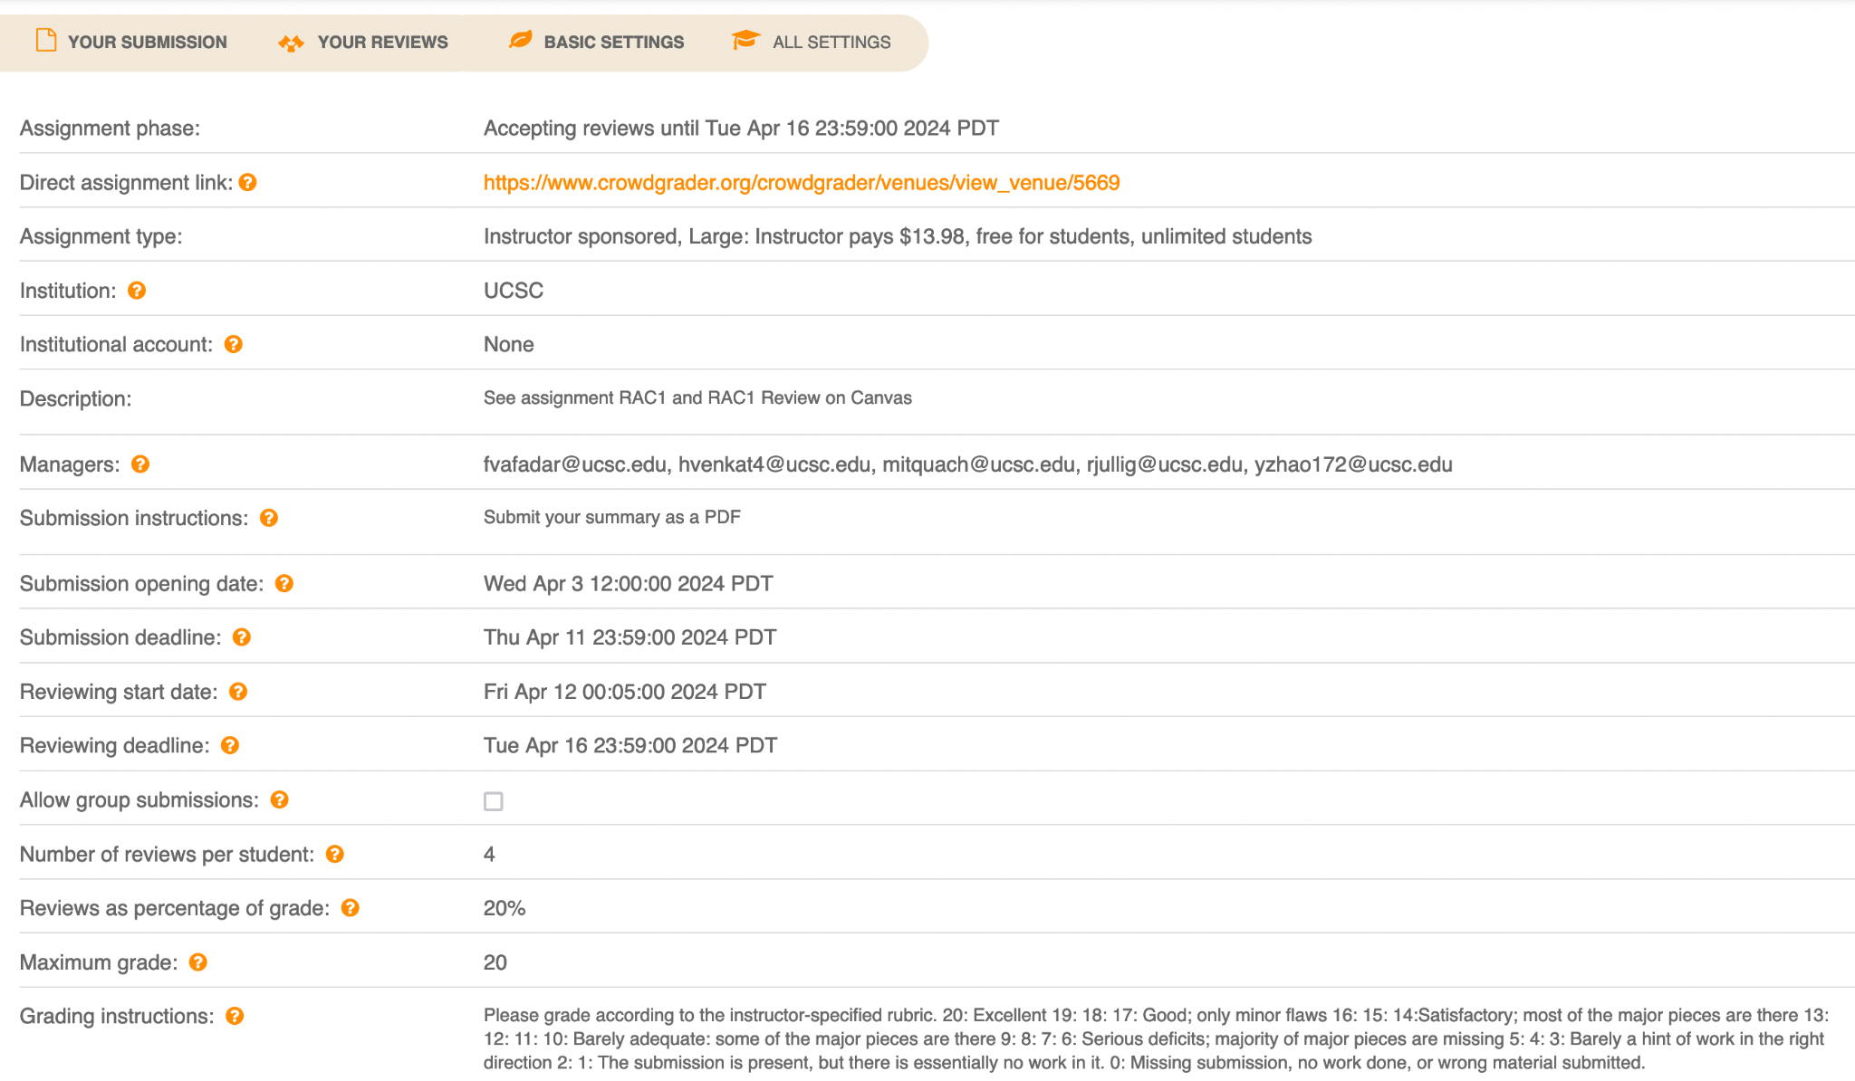
The Problem

Slide 4
Our Solution
Professors
Students
Professors don’t have the bandwidth to grade hundreds of students
Provide a cheap, modern design, with integration to Canvas gradebook for easy grade publishing
Students don’t like the current tool, Crowdgrader
A more intuitive interface increases usability and confidence about submissions & grading

Slide 5

Project Scope
Peergrader will provide…
Intuitive UI
Customizable courses/ assignments
Grade peers
Get timely feedback

Slide 6
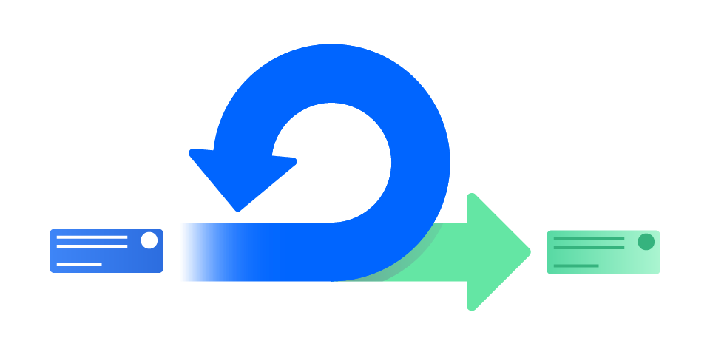
02
Sprints

Slide 7
Sprint 1
User Stories
As a student I want to see my dashboard with my courses and assignments that I need to complete in an organized manner.
As an instructor I want to be able to create a course and see all the students in my course.
As an instructor I want to create an assignment with a specific rubric per assignment and assign it to a course.
As a user I want to be able to login securely with the option for different account authentication methods
Spikes
Learn next.js, React, Typescript
Infrastructure tasks
Set up Supabase auth, database, storage bucket
Set up Github repo

Slide 8
Sprint 2
User Stories
As a student I want to be able to go to an assignment and turn in a file.
As a student I want to be able to see all the people I need to grade, be able to see their submissions, and give them a grade based on the rubric for that assignment
As an instructor I want to be able to customize the score based on grading, grading score, and score on rubric. And customize assignment deadlines - submission and grading.
Infrastructure tasks
Add more tables to the postgresql database

Slide 9
Sprint 3
User Stories
Students should be given a grading score based on how well they graded others.
As an instructor I want to be able to see the progress the class has made on turning in and grading.
As a student I want to be able to see the scores I have been given and what I lost points for.
As a student or teacher I want to be able to customize my profile.
Spikes
Set up testing environment

Slide 10
Sprint 4
User Stories
As a student I want to be able to dispute a score.
As an instructor I want to be able to sync grades with Canvas API.
As an instructor and student I want to be able to notify students/get reminders about assignment deadlines and grades.
Spikes
Learn how to use Canvas API
Increase security
Infrastructure tasks
Set up Vercel deployment

Slide 11

03
Planning

Slide 12
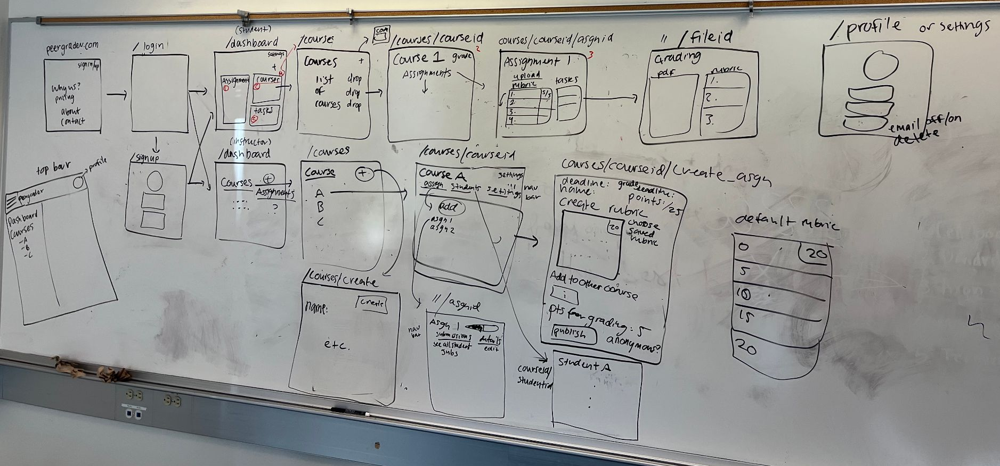
Website Outline

Slide 13
Architecture
Backend Server
(Supabase)
Client
Web Server
(Vercel)

Slide 14




Technologies
Supabase
Next.js
Vercel
Auth, postgresql, storage
React-based web framework
deployment
Tailwind
Frontend - styling

Slide 15
Challenges/Risks
Security
Scaling
Competition
Providing secure website and a secure database that prevents unauthorized access to user files and course data.
Will need to optimize website reads and storage to not incur high costs.
Crowdgrader
Peergrade.io
Peermark (turnitin)

Slide 16
MVP
Students
Professors
Join a course
Upload PDFs of their work to an assignment
Are assigned and can grade other students based on professor rubric
Create courses, invite students
Create rubric and assignments
Get final student scores

Slide 17
Thanks!

